Slide 1


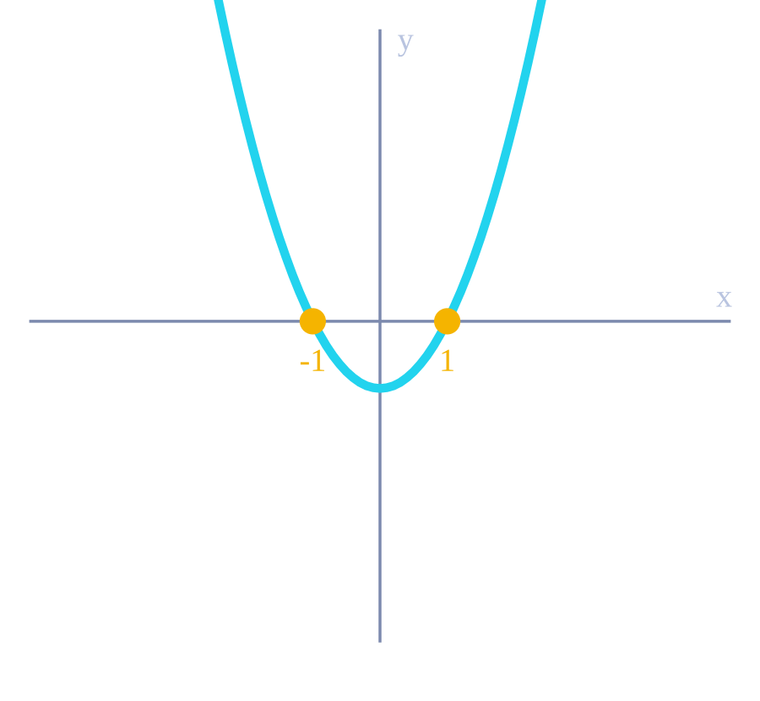
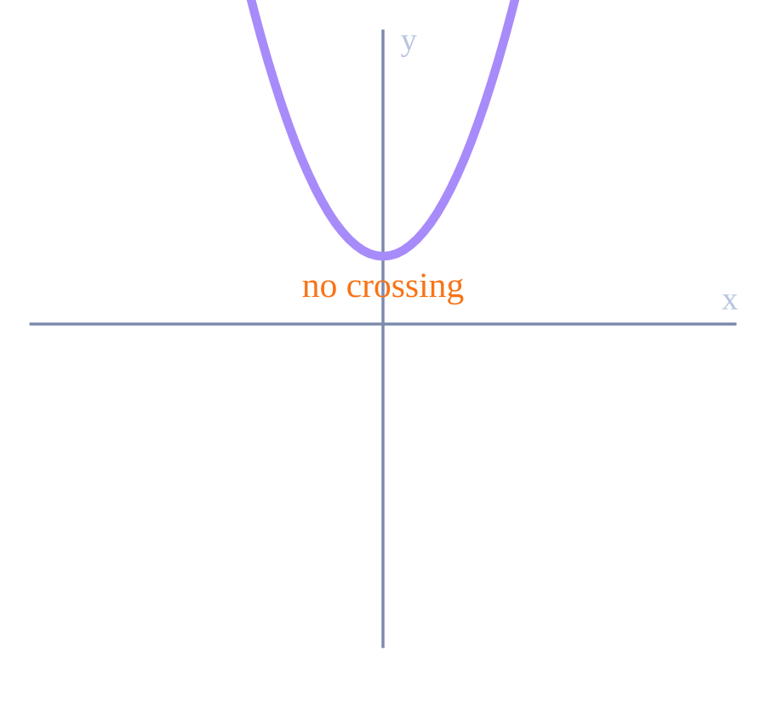
THE MYSTERY OF THE NEGATIVE SQUARE
DISCOVER
LEARN
UNLOCK
MASTER
An Introduction to Complex Numbers • Level 1: The Question
"Can a real
number square
to -1...?"
Concept: Squaring any real number never gives a negative result. So does a solution exist for x² = −1 ?
EQUATION 1
EQUATION 2
x² − 1 = 0
x² + 1 = 0
⚠ WARNING SIGNAL
The graph of f(x) = x² + 1 never touches the x-axis — it has no real x-intercepts, so no real number solves the equation.
✨ KEY TAKEAWAY
Real numbers alone cannot solve x² = −1 — mathematics needs a brand-new kind of number.
x = ±1 — real roots exist
x = ±√−1 = ?

Slide 2



MEET THE IMAGINARY UNIT
DISCOVER
LEARN
UNLOCK
MASTER
Level 2: The Discovery
i = √−1
i² = −1
the imaginary unit
the defining rule of every power of i
CONCEPT
REAL vs IMAGINARY
Because equation 2 has no real solution, mathematicians created a new number whose square is allowed to be negative.
Real: x² ≥ 0 always
Formula card: x = ±√−1 is written as x = ±i
Imaginary: i² = −1
✨ Key takeaway: Every power of i can now be built from this one fact — i² = −1 unlocks the entire pattern.
This single new rule lets us find a square root for any negative number.

Slide 3

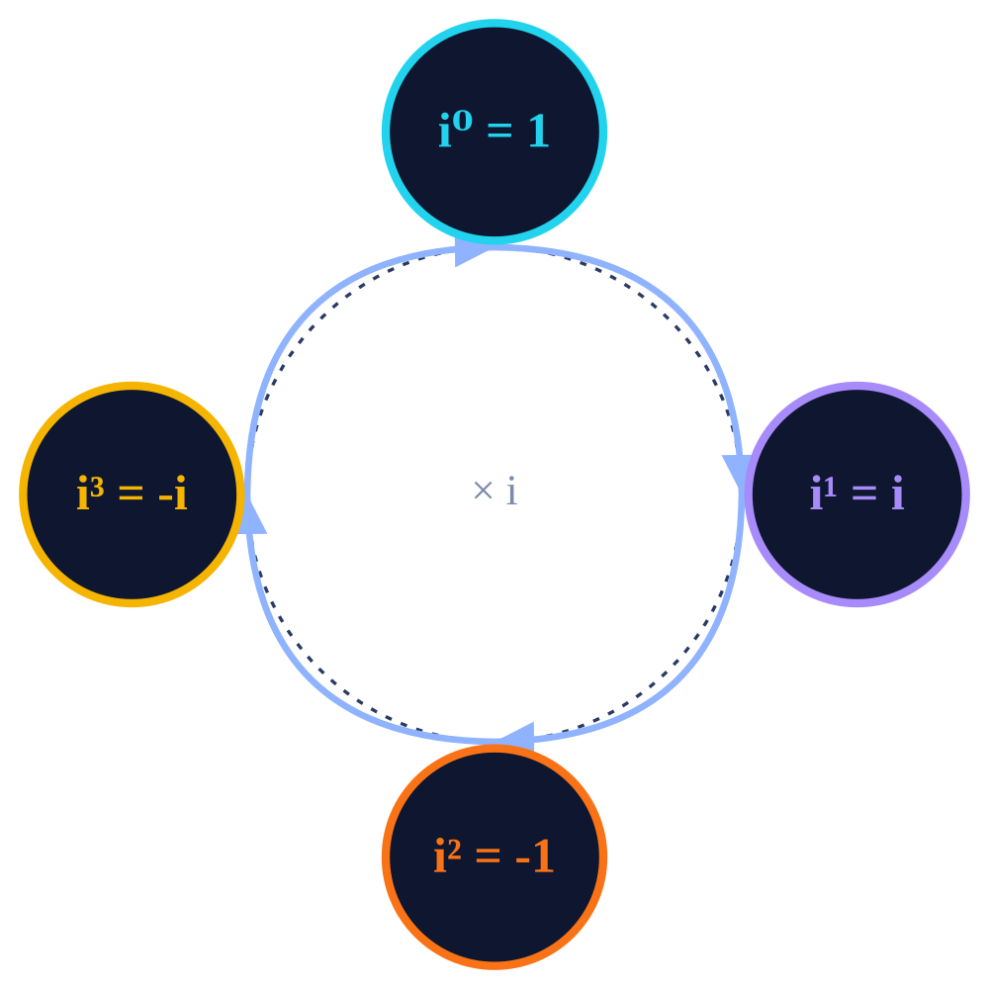
THE POWER CYCLE OF i
DISCOVER
LEARN
UNLOCK
MASTER
Level 3: Rules + Worked Examples
WORKED EXAMPLES
FOUR BASIC VALUES
Simplify i⁷
i⁰
= 1
i⁷ = i⁴⁺³ = (i⁴)·i³ = 1·i³ = −i
i¹
= i
i²
= −1
Simplify i¹⁷²⁹
1729 ÷ 4 = 432 rem 1 → i¹⁷²⁹ = (i⁴)⁴³²·i¹ = i
i³
= −i
✅ PATTERN
Simplify i⁻¹⁹²⁴ + i²⁰¹⁸
Powers of i repeat every 4 steps: 1, i, −1, −i, then back to 1. Divide the exponent by 4 — only the remainder matters.
both exponents ≡ 0 (mod 4) → i⁰ + i⁰ = 1 + 1 = 2
Rule: iⁿ = iᵏ where k = n mod 4

Slide 4


MASTERING THE RESULT
DISCOVER
LEARN
UNLOCK
MASTER
Level 4: Key Result, Caution & Practice
IMPORTANT RESULT
QUICK PRACTICE
iⁿ + iⁿ⁺¹ + iⁿ⁺² + iⁿ⁺³ = 0
Q1
i¹⁹⁴⁷ + i¹⁹⁵⁰
The sum of any four consecutive powers of i is always zero, for every integer n.
CAUTION
Q2
i¹⁹⁴⁸ − i¹⁸⁶⁹
√(ab) = √a·√b only holds if at least one of a, b is non-negative.
Q3
∑ i^{n} for n = 1 to 12
Counter-check: 6 = √36 = √(−4)(−9) ≠ √−4·√−9 = (2i)(3i) = −6

